Slide 1
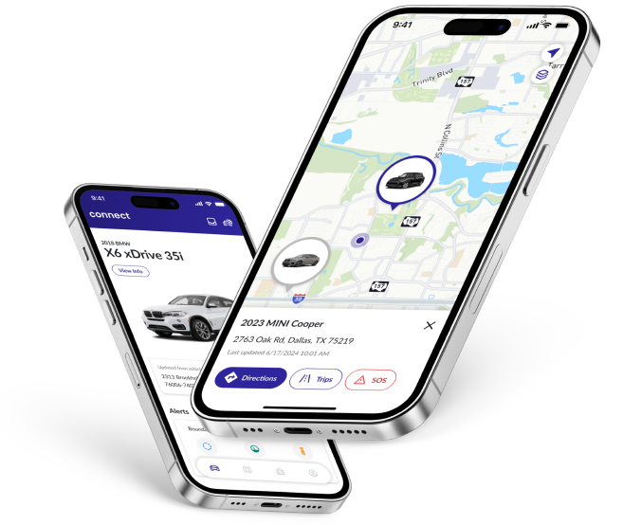


Dealer Branded, No-Cost Lot-Management and Retention Marketing
INTRODUCING THE IKON ENTERPRISE SOLUTION
Presented by
Salesperson X

Slide 2
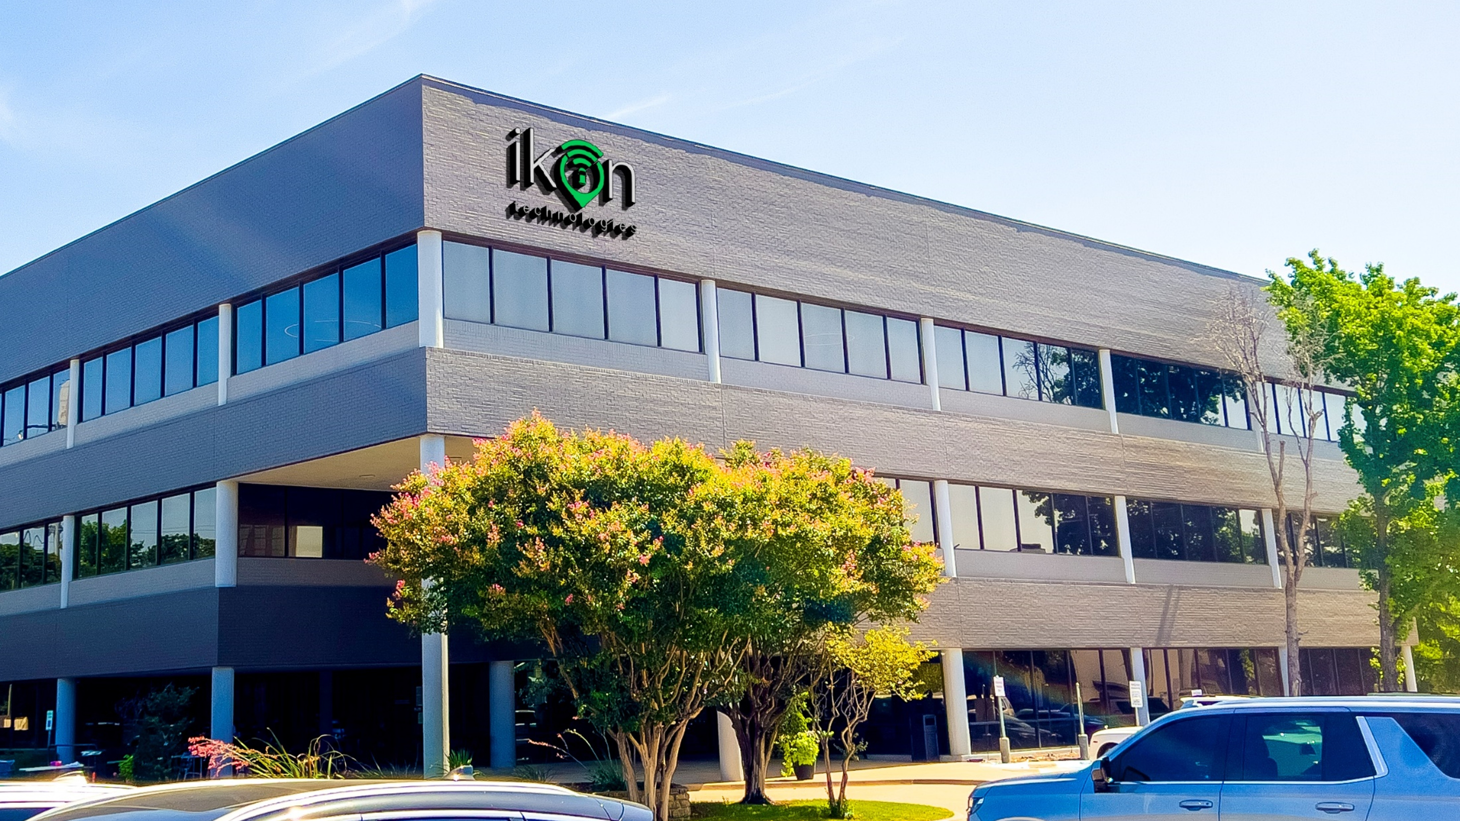
Who We Are
  Ikon is founded by tech savvy dealers that have been leveraging technology for decades
  Over 20 million invested in software and hardware
  Used by Dealers Coast to Coast
  Multi-level customer support team
  Part of a Multinational Organization

Slide 3

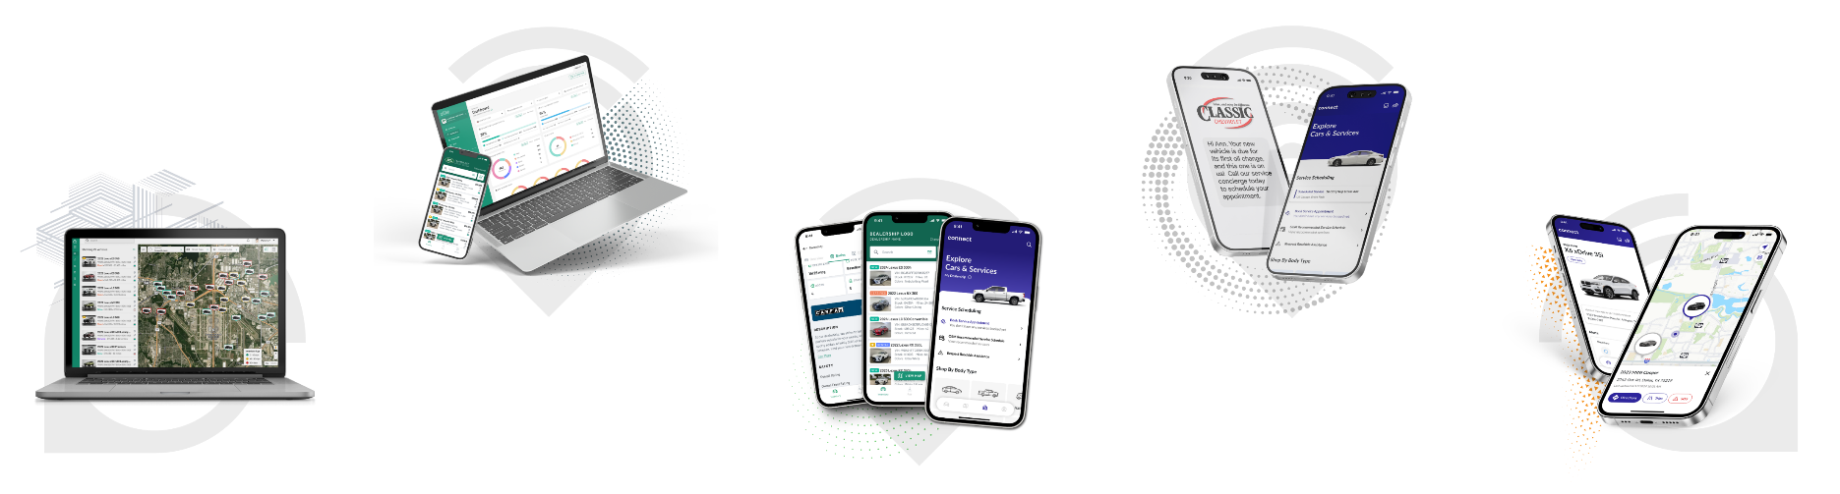
Product Benefits to Dealers
Improving A Dealer’s Connection to Customers Every Step!
Manage Inventory and Risk
Add Sales Profit
Improve Customer Loyalty and Dealer Branding
Increase Sales Efficiency and Effectiveness
Grow Service Revenue
and Repair Orders
Notes:
1

Slide 4

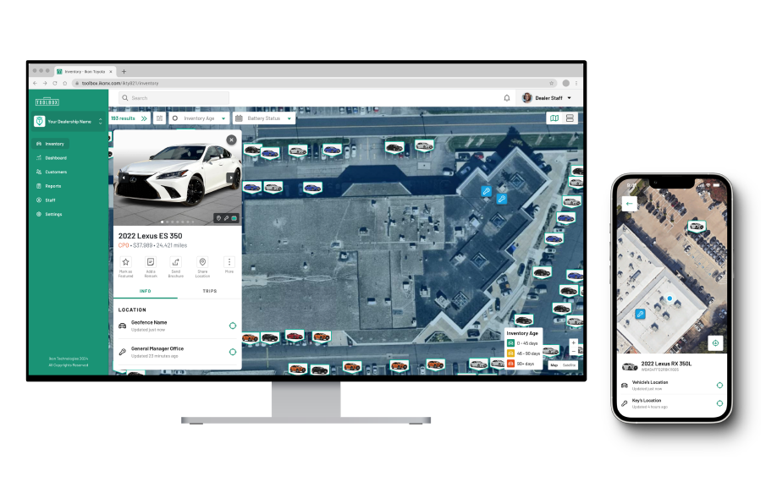
No Cost Lot Management
45 Minutes saved per sale
No-Cost Lot Management
  Find the Car, Find the KeysTM
  Theft Deterrence/Recovery
  Integrated Car and Key Location
  Battery Status Reporting and more
Inventory Age Indicator

Slide 5

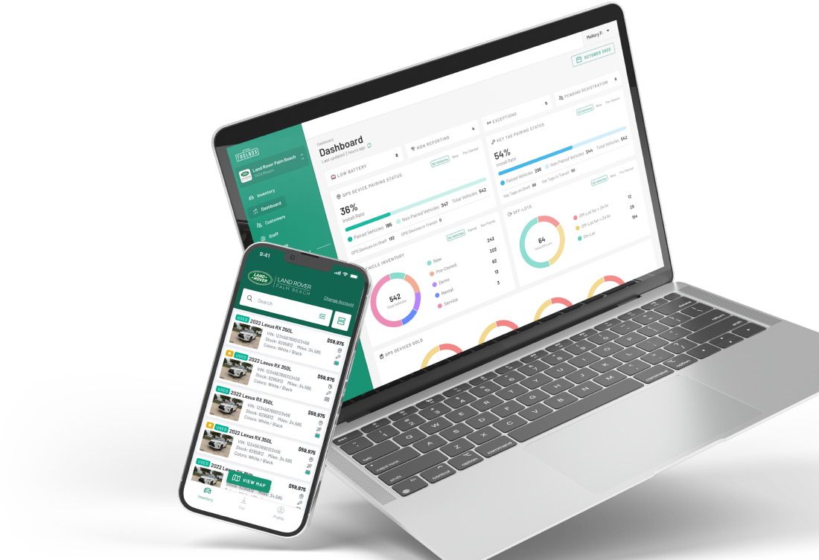
Business Building Platform
Business Building Platform
A platform that builds a long-term relationship with customers.
  Connected Car Value-add
  Grows Per Vehicle Revenue
  Builds Your Customer Database
  Powers Retention Marketing
  Drives ROI You Can Measure

Slide 6



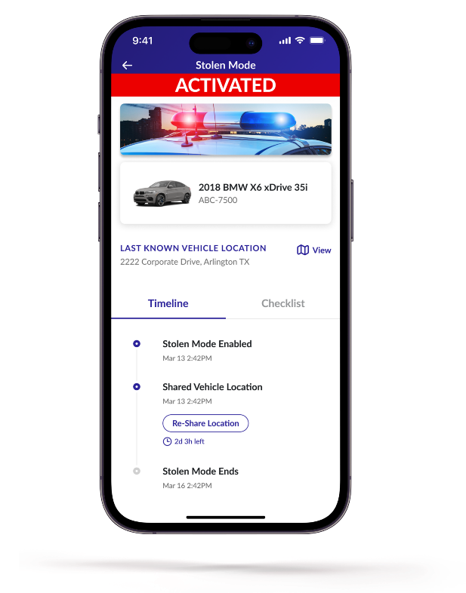

Stolen Vehicle Recovery
Minutes
AVERAGE VEHICLE RECOVERY TIME
Locate Nationwide
24/7 Vehicle Recovery
CLICK HERE
Ikon Theft Warranty
3,000 Dealer Benefit
Up to $10,000 for your customer
$1,000 toward Car Rental
$1,000 toward Insurance Deductible
$8,000 toward the Purchase of Replacement Vehicle

Slide 7

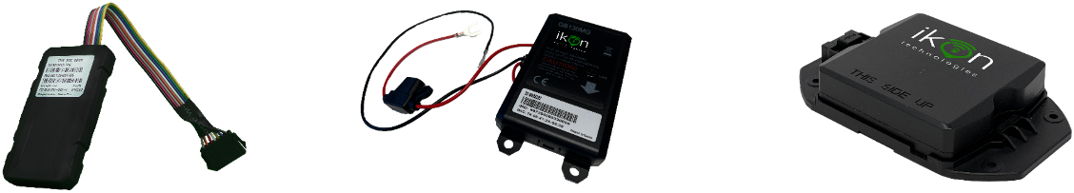

Solutions for your Needs
Ikon is Better for Consumers, Better for Dealers
OBDII Device
Direct Connect
Rechargeable Wireless
63% average penetration.
Non-Cancellable
  TLP insurance bundled with Connected Car/Dealer App
  Uplift lower PEN products (etch replacement, or "Total Protection Package Bundle")
Easy Install
Direct Connect
Wireless
Backup Battery
Backup Battery
Rechargeable
Pings once every 24 hours when no movement
Pings once every 24 hours when no movement
1 Ping a day
= 3 years of battery life
Pings every 2 min when driving
Pings every 2 min when driving
Advanced Start/Stop Report = 15 months battery life
Notes:
3

Slide 8


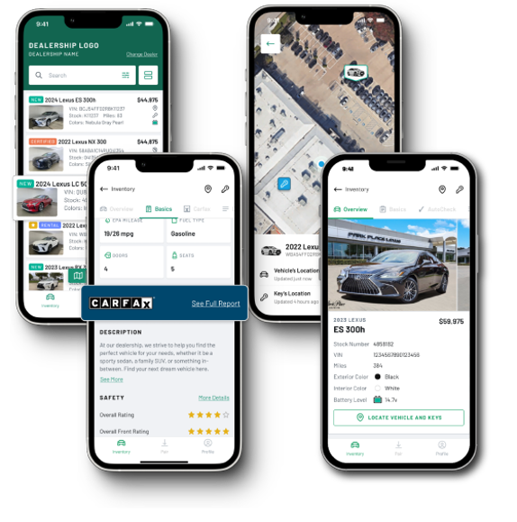
Dealer Toolbox
Increase sales efficiency
The Ikon Dealer Toolbox is a huge help for this staff. It just speeds up the whole sales process.
Mike Mattingly
St. Louis, MO (South County Dodge, Chrysler, Jeep, Ram)
  All the necessary selling detail at your fingertips
  Vehicle features, Safety Ratings, and vehicle history reports
  Exact location of inventory & keys
  No more walking up to a dead battery
  Stay engaged with customers, reduce/eliminate lost sales opportunities
  Improve your CSI Rating
Notes:
Standard language, no editing.
Screenshots updated January 2022.
5

Slide 9

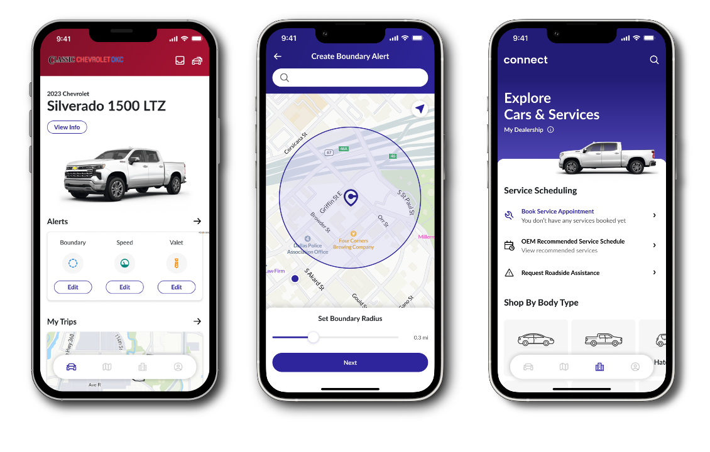
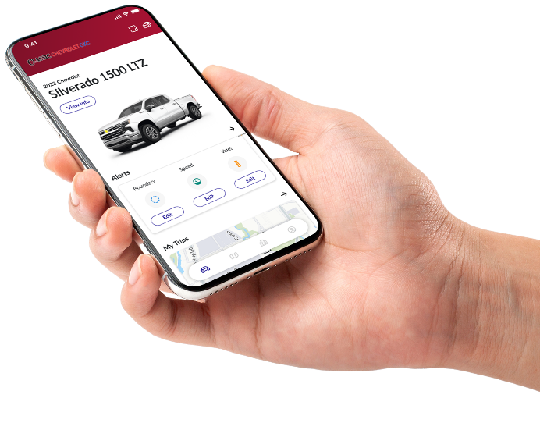


Dealer Branded Consumer App
Strengthens Dealer-Driver Relationship
240+ Interactions
5.4 Hours/Day Screen time
Keeps Dealer Name in Front of Customers
Dealer Associated with Safety and Convenience
Customers Stay Engaged 5+ Years
Notes:
Your own App supporting your Dealership/Group not the OEM.
Captured Audience – why a dealer app by itself doesn't stay
High usage by customers 15 times per month
Stay connected for 3-5 years
Future Service, Sales and trade in possibilities
"Users of dealership apps tend to come in for 25% more service visits than non-app users."
7

Slide 10


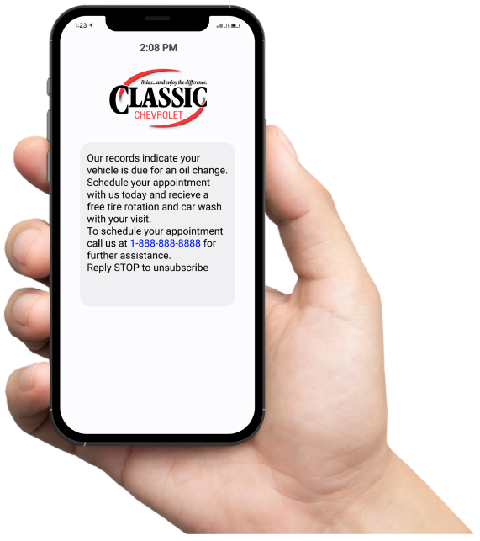
Dealer Branded Smart Marketing
Your brand...Your APP Owning the relationship with your customer
  Branded Loyalty Program
  Your Branded Mobile App
  Your Branded Service Alerts
  Your Branded Campaigns
  Your Branded BDC
  IKON Call center to help drive service appointments

Slide 11

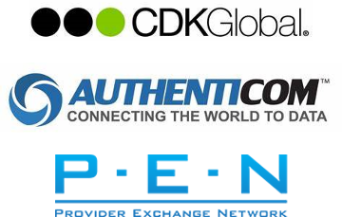


Integrated with:
Designed for Compliance
Business Credibility and Trust
Regulatory Compliance and Legal Protection
Simplified Vendor Management
Security and Risk Management
Financial and Business Growth
Client Retention and Satisfaction
Operational Efficiency

Slide 12


Pricing & Implementation
No up-front capital expense for devices
Pre-load entire dealerships inventory:
$20 initial install per vehicle includes:
  Launch team to train entire dealership staff
  Train/certify dealer’s installers
  All Dealer Branded Point Of Sale,
  Training & Marketing Materials
We Invest in Our Dealer Partners!
3-5 years post sales marketing which includes Ikon’s complementary BDC for service and sales retention.
(No additional cost to the dealer)
We align our profit with our dealer partner’s.
Reinsurance friendly theft guarantee with low single digit loss ratio, hard add / non-cancelable income for the dealer with zero Admin fee.
Dealer reserve for reinsurance program is $50 minimum per contract
Description | No Sale | 3 Years | 5 Years | 6 Years | 7 Years
Total Pricing | $59 | $249 | $299 | $309 | $319
Sales Enrollment Rate | Rebate Amount
30% | $30
40% | $40
50% | $50
60% | $60
Notes:
Text is editable
9

Slide 13



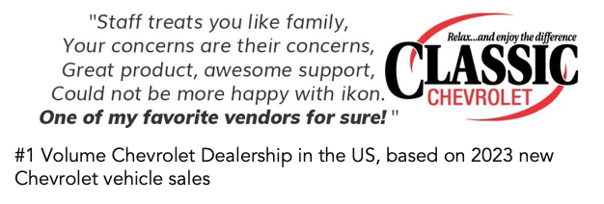
What Our Clients are saying

Slide 14

Phone Number
Thank You
123-456-7890
Email Address
Reach out to our team to get for any inquiries or clarifications.
hello@reallygreatsite.com
Because Connectivity Drives Customers Back to the Dealership

